Slide 1
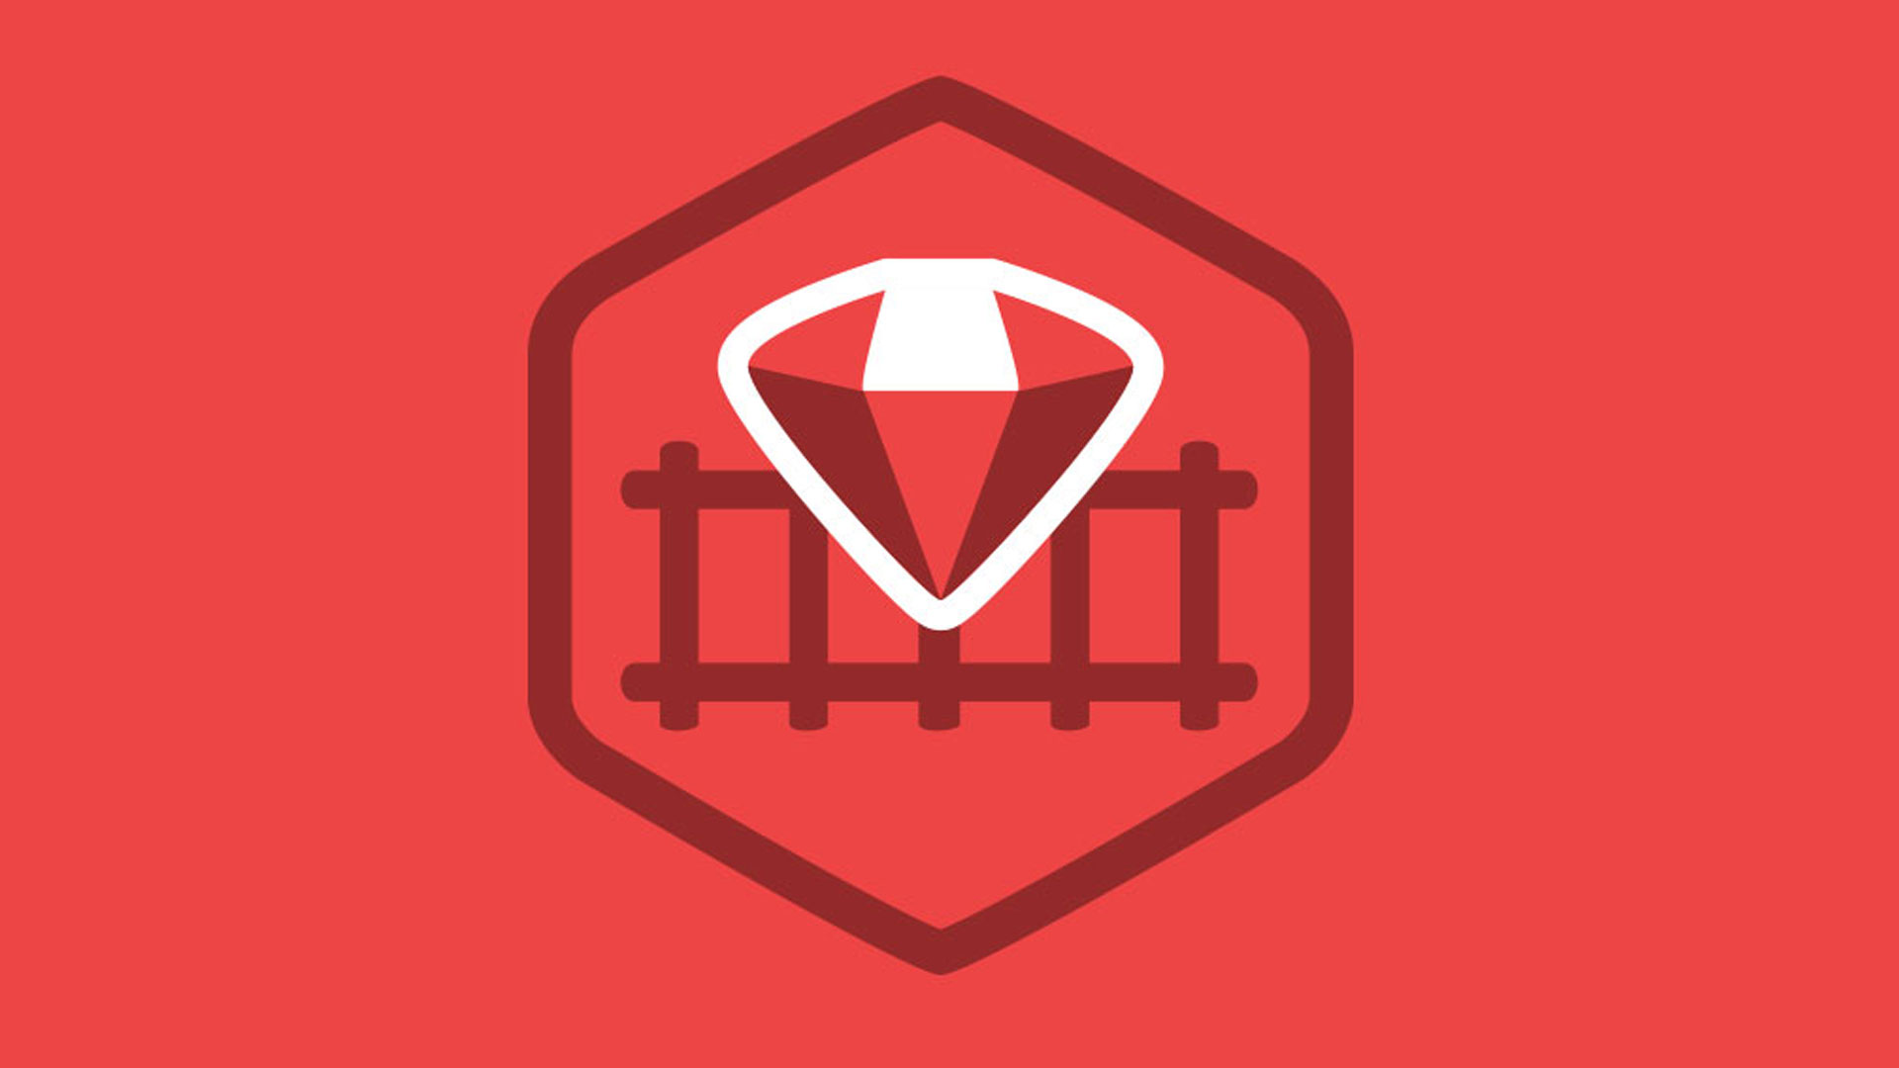
Ruby on Rails

Slide 2
About today…
Ruby on Rails
Intro to Controller Security

Slide 3
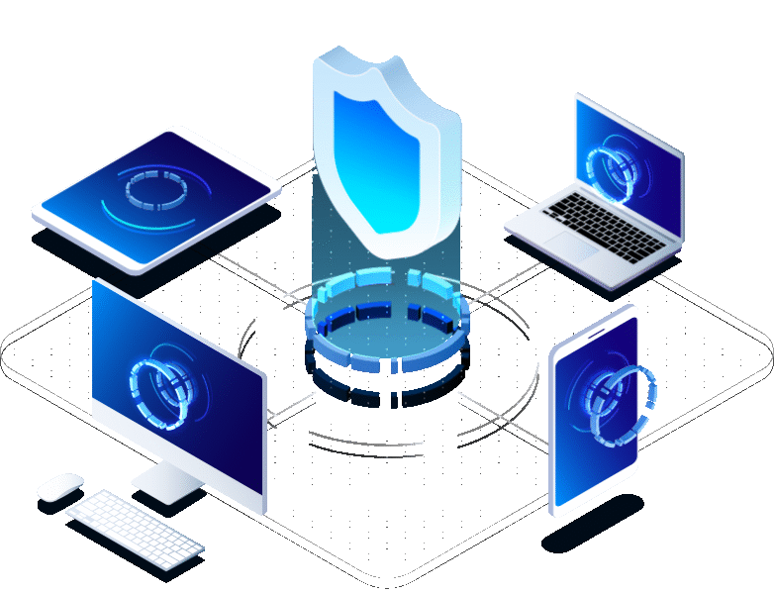
Controller
Security

Slide 4

Introduction to Controller Security
Purpose
Controllers handle requests and define actions that users can perform
Security Need
Security measures ensure only authorized users can access specific actions

Slide 5
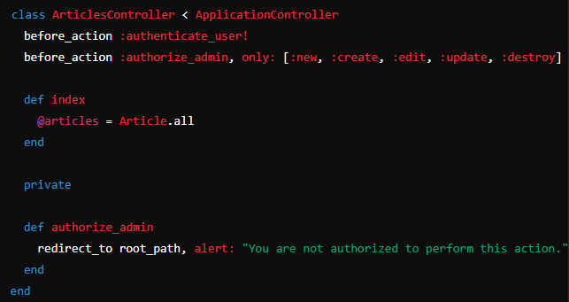
Using Filters for Access Control
Before Action Filters
Purpose
Ensure actions require authentication and authorization before execution
Implementation
Use before_action to enforce access control

Slide 6

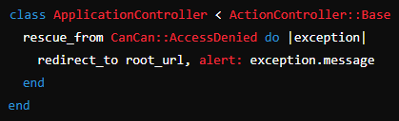
Handling Unauthorized Access
Rescue from CanCanCan Access Denied
In app/controllers/application_controller.rb

Slide 7
Testing Security Measures
Purpose
Verify login/logout functionality and role-based access control
Steps
Test with different user roles to ensure permissions are enforced correctly

Slide 8


Slide 9

What is the primary function of controllers in a Rails application?
Which method is commonly used in Rails controllers to enforce access control before executing specific actions?
In the provided example, what does the before_action :authenticate_user! line ensure?
How can you handle access denied exceptions in Rails?
What is the purpose of testing authentication and authorization in a Rails application?

Slide 10

Task 1
Add before_action filters to controllers requiring authentication and specific roles
Task 2
Test access to actions using different user accounts to ensure proper enforcement

